Slide 1
CA163 Hands-on experience with SAP Enterprise Threat Detection
Kirti Singh, Arpita Deshpande, Shivaprasad Naik, Ankit Sharma
November 2025

Slide 2


Agenda
Introduction SAP Enterprise Threat Detection, cloud edition
SAP Enterprise Threat Detection, (public ) cloud edition for Private/Public Cloud SAP Landscapes
Short Preview
Starting UI
Dashboards (preview)

Slide 3
Introduction SAP Enterprise Threat Detection Cloud Edition

Slide 4

What is SAP Enterprise Threat Detection
SAP Enterprise Threat Detection raises alerts in (near-) real-time, if security/compliance relevant suspicious activities happen in the application layer of your SAP landscape.
SAP Enterprise Threat Detection uses HANA technology to digest mass data log volumes, and run highly efficient automated processes to track hacker activity using SAP's predefined and easy customizable use cases.
Notes:
The solution runs patterns and applies algorithms and statistical analysis to detect meaningful anomalies related to suspicious (user) events, correlates events, even over time, and detects anomalies in user behavior that indicate potential threats and fraud within SAP applications.
Our mission is to protect SAP S/4HANA applications and stop critical cyber-attacks.
In today's world, where cyber-attacks are increasing dramatically, companies need to go beyond preventive measures and bring real-time detection and response into the focus. This no longer applies only to the IT infrastructure layer, but also affects business systems such as SAP S/4HANA. Detecting, analyzing and responding to threats is a must to protect core business systems like SAP S/4HANA applications.
SAP Enterprise Threat Detection Cloud Edition gives transparency in real-time into suspicious (user) behavior an anomaly in SAP business applications to identify and stop security breaches in real-time.
It uses highly efficient and automated processes based on HANA technology to track hacker activity using predefined and easily customizable attack path patterns.
SAP Enterprise Threat Detection Cloud Edition is built to provide customers a unique service to get his Security Alerts managed and processed in a compliant way, without the need to build up corresponding deep SAP security knowledge, or to find such persons in particular.
Now companies can make use of the proven technology of SAP Enterprise Threat Detection to safeguard the operation of the SAP S/4HANA environment and ensure the continuity of the business without building up deep SAP security knowledge or a security operations center for SAP.
This is achieved and delivered by the embedded shared service plus the upcoming additional premium services for individual forensic analysis, threat hunting and SLA based response services.
This service as well reduces customer effort for conducting audits, managing compliance to regulatory requirements and company policies.
The loss of relevant audit log information is stopped at a low financial investment that enables our customers to concentrate on the real business objectives.
SAP Enterprise Threat Detection Cloud Edition is suitable for all sizes of customers. SME customers mostly might decide for the Cloud Edition because of the issues about velocity and costs. Large customers might decide for the cloud edition because of the same reasons, or because of an overall go-to-cloud strategy.
Operational Categories:
Access of sensitive information
Critical system configuration changes
User management & privileged user management
Critical system communication
User log-in management

Slide 5





Use case categories
Use of critical resource
Execution of critical functions, reports and transactions
Change, manipulation or spy out of business data
Change or manipulation of critical configuration
User Manipulation
Critical authorization assignment
User role create, drop or manipulation
Reference user assignment
User morphing by changing type or probable identity theft
Debugging
Debugging with change of control flow while debugging
Debugging with change of variable values during debugging
Debugging in critical systems
Debugging in systems assigned to critical roles
System Access
Failed logon with too many attempts
Failed Logon with too many password logon attempts
Logon with SAP standard users, or high privileged users
Suspicious Actions
Dynamic program execution, download
Dynamic code and system changes

Slide 6
SAP Enterprise Threat Detection, (public) cloud edition for Private/Public Cloud SAP Landscapes

Slide 7
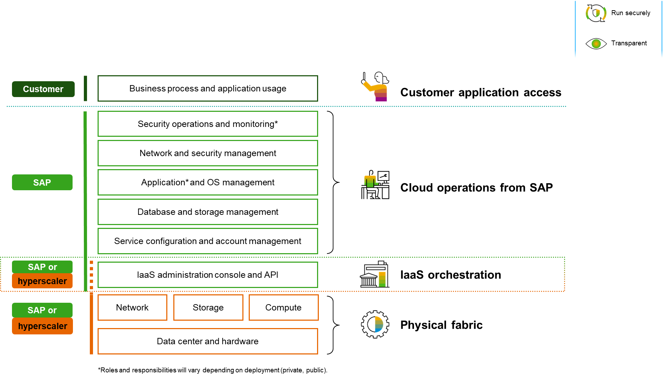
SAP S/4HANA Private/Public Cloud: Shared responsibility
Use of SAP Enterprise Threat Detection
for In-Application monitoring

Slide 8
Short Demo/Preview

Slide 9
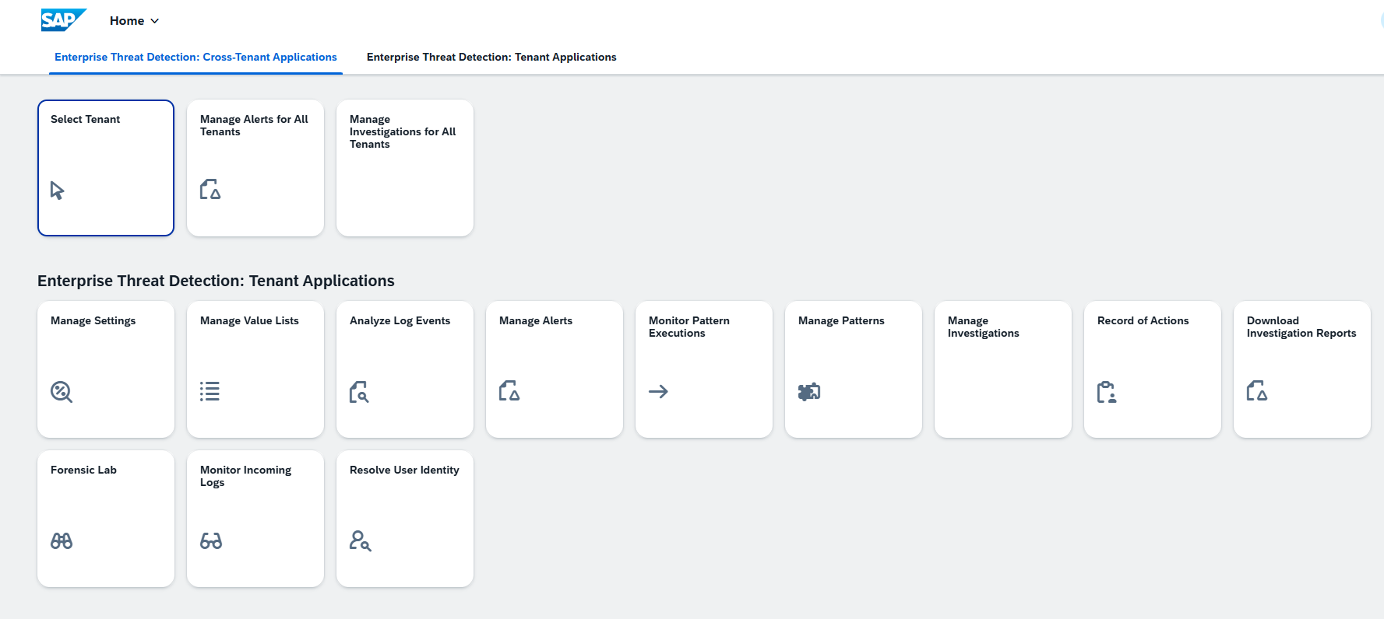
Security Analyst View/Partner View
The Security Analyst
does alert processing, deep dive analysis, new use case creation, …
has a lot of tools at hand to do his job

Slide 10
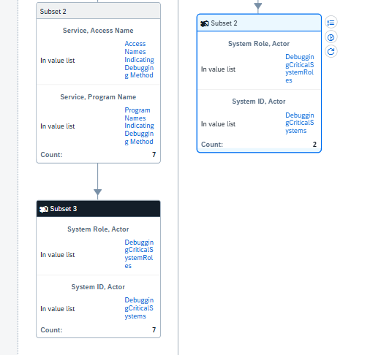
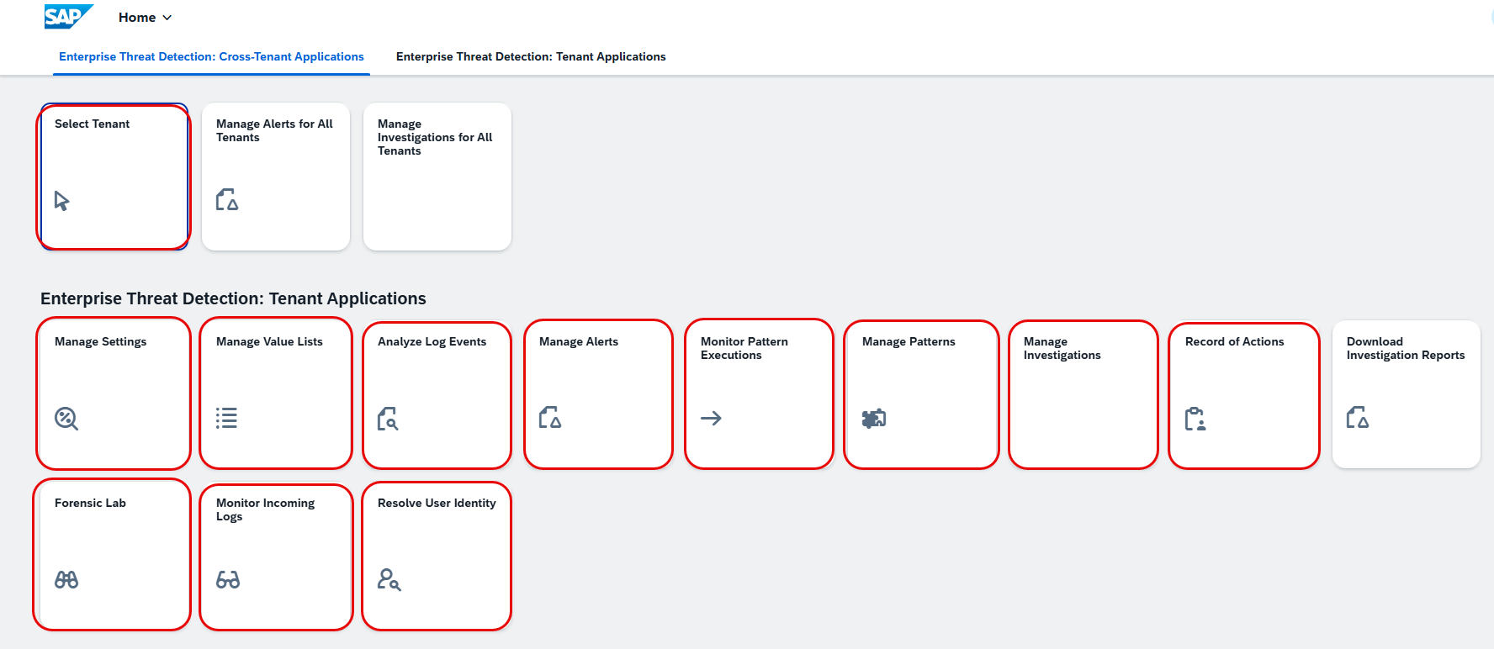
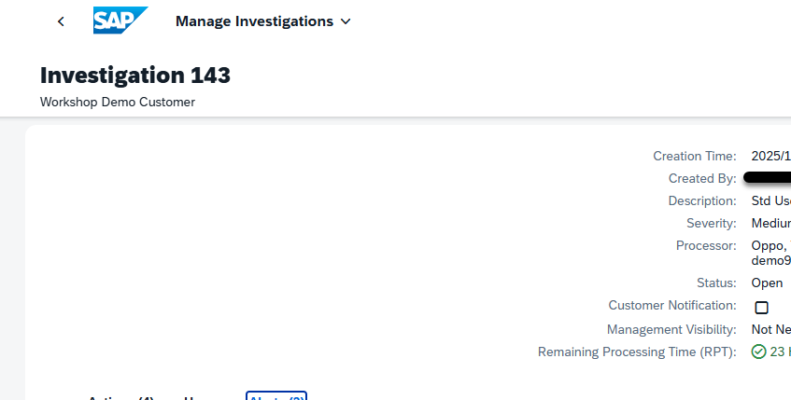
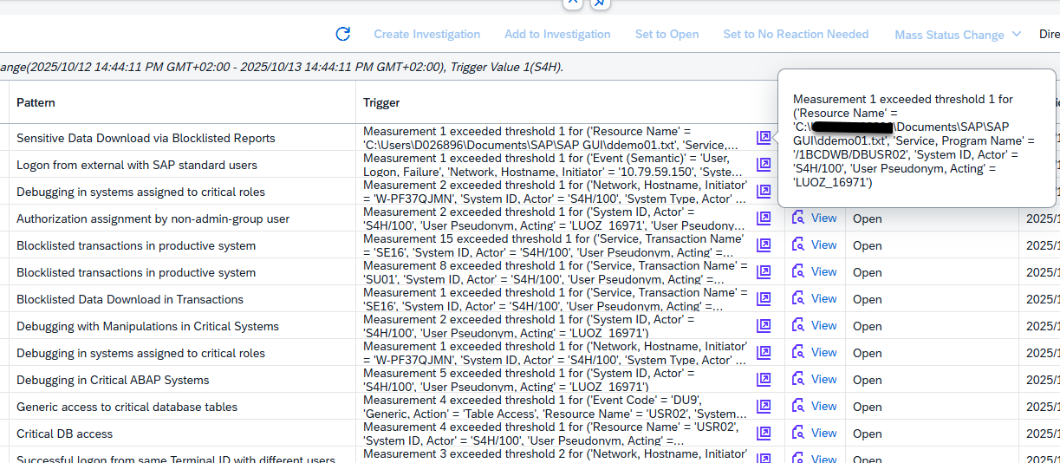
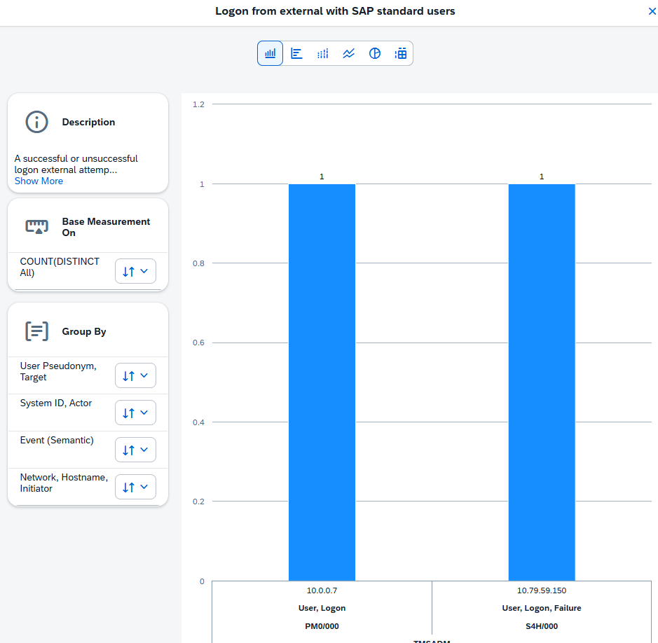
Hands-on goes through

Slide 11
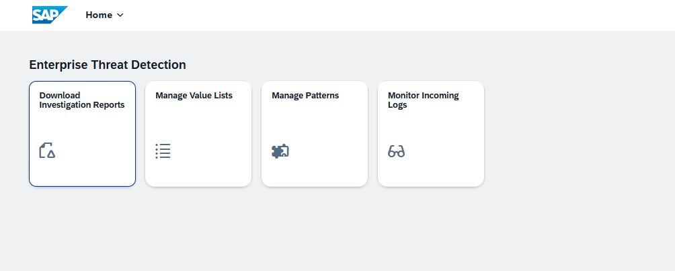
Processor View
The Processor
is another persona than the Security Analyst
mainly consumes the results of the analysis

Slide 12
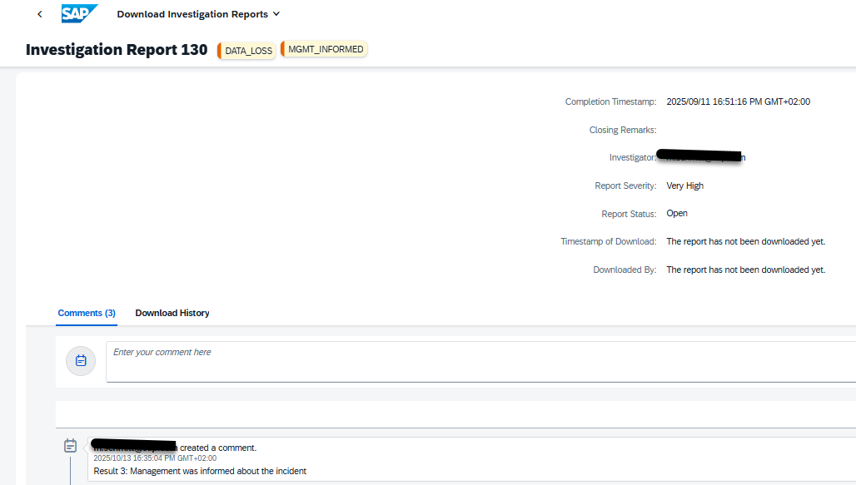
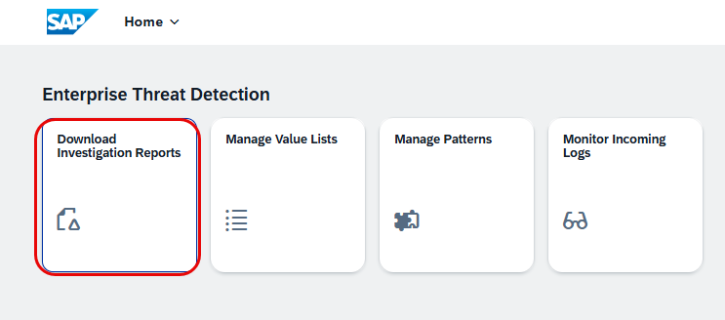
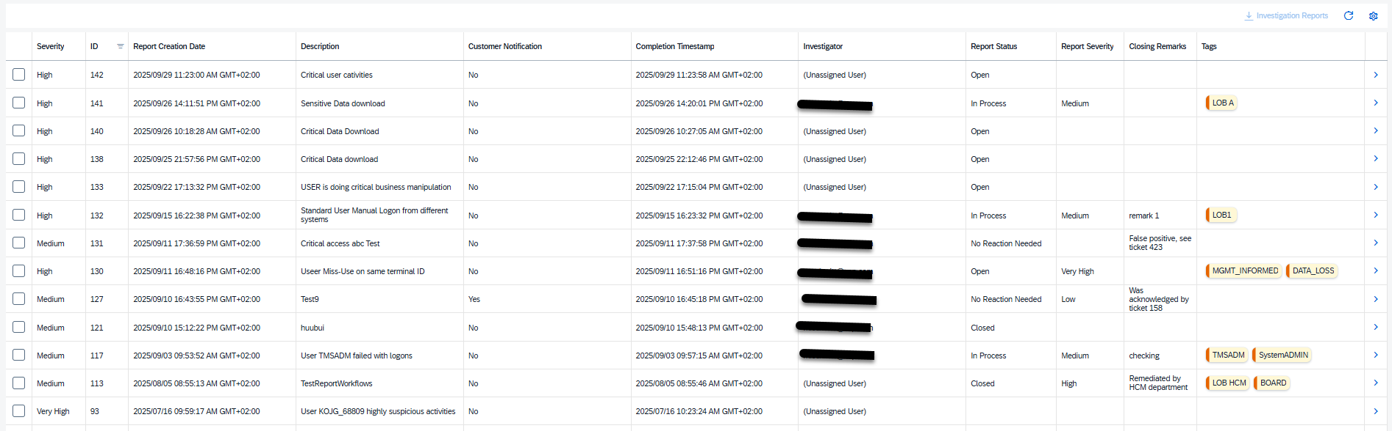
Hands-on goes through

Slide 13
“Quote goes here and here.”
Source

Slide 15
Contact Information:
Kirti Singh
Product Manager
kirti.singh01@sap.com
Michael Schmitt
Product Manager
m.schmitt@sap.com

